Slide 1
Group Members: Simon Swifter, Elliot Parrish, Andrew Clarke
Major things that we did to format the data:
-We removed the unnecessary column of storm names, they were not used at all
-We realized that some of the data was off by a factor of 10 (latitude and longitude specifically). We think that if a number ended with a 0, it was not recorded properly. A 30 would become a 3.0, a 15 became a 1.5… So we searched for these small numbers in each and multiplied them by 10 to fix this.
-We realized that “NOT NAMED” was actually 2 columns, so we fixed this by combining them. The last column also gave us some troubles. It was too long for the way we were trying to manipulate it so we ended up just having two columns for the storm type.

Slide 2
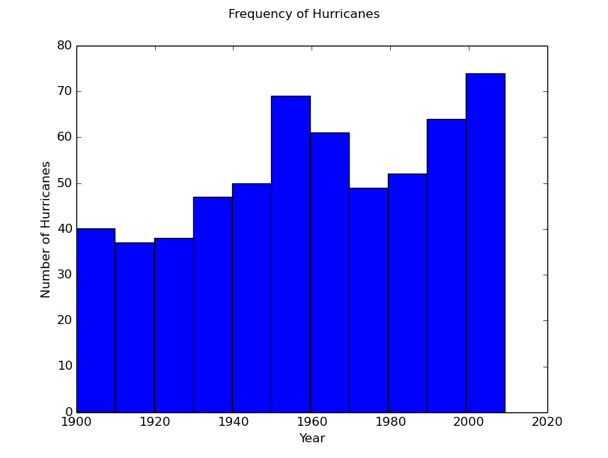
Question 2
We fit this data with a linear equation, and the equation that fits it gave us a value of 76 hurricanes at 2030.

Slide 3
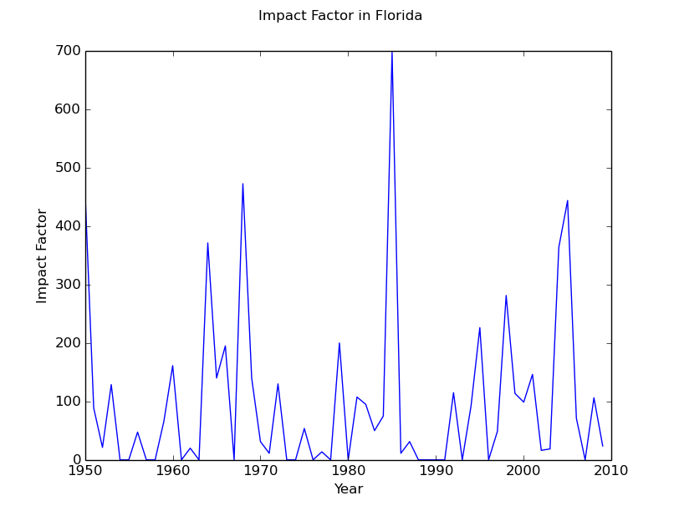
Question 3
The problem does not appear to be getting worse. There are some years with much higher impacts, but overall the distribution seems fairly random.

Slide 4
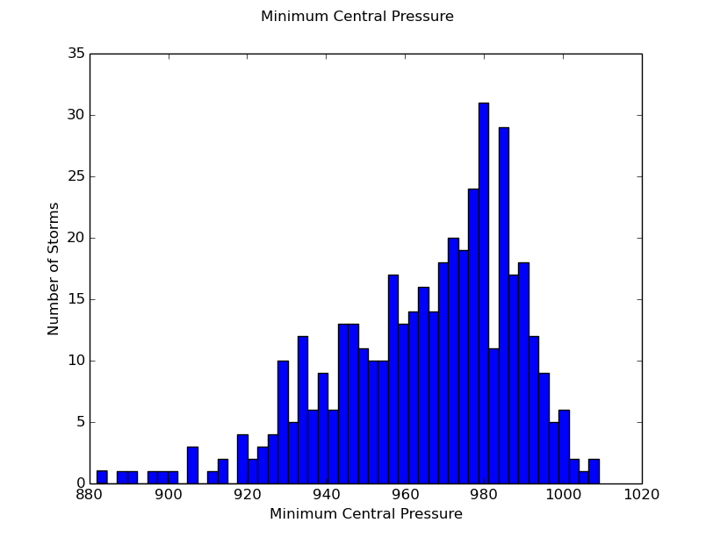
Question 4
The mean is 965.152 and the standard deviation is 22.664. There are points slightly outside of 3 standard deviations. 99.73% should be within 3 stds, with the number of storms we’re looking at, this seems to be what we would expect.

Slide 5
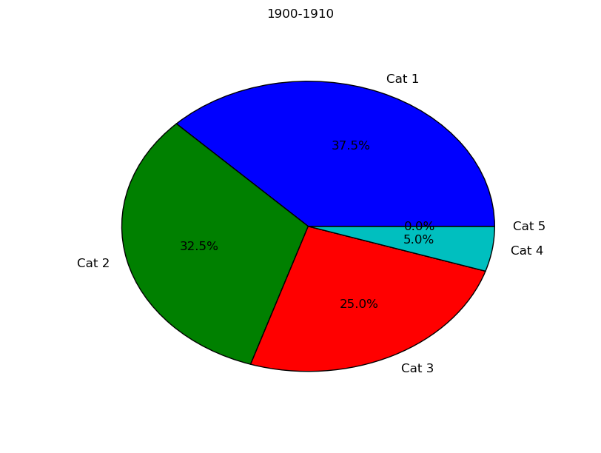
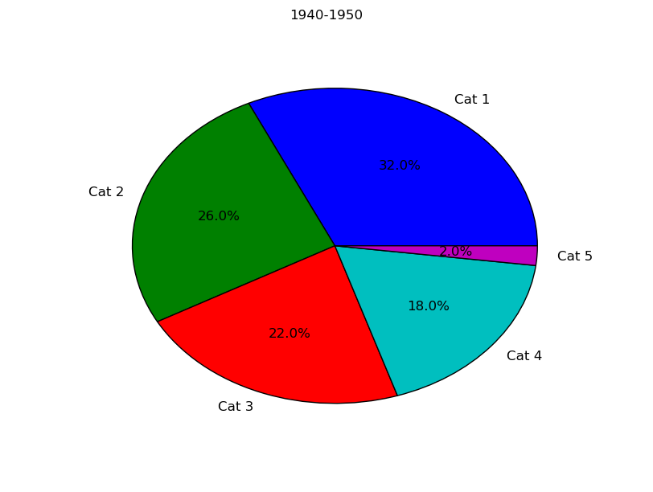
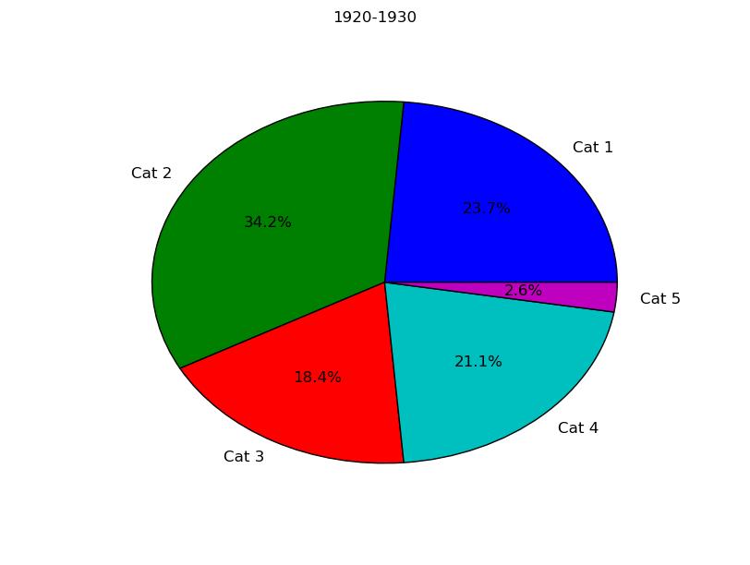
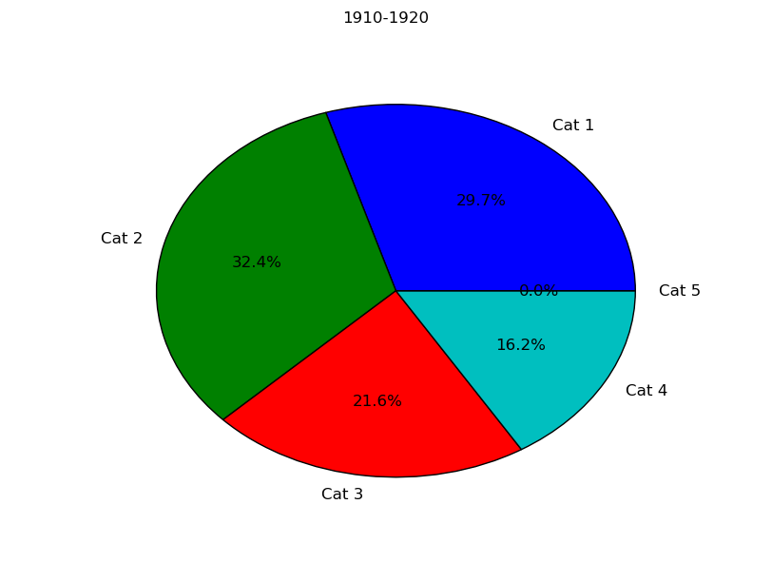
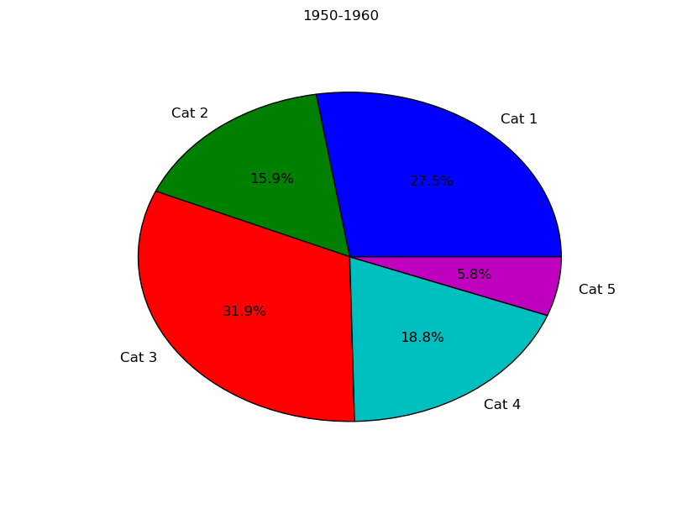
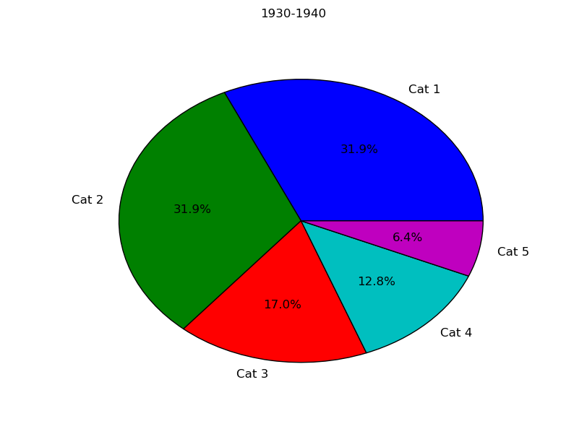
Question 5

Slide 6
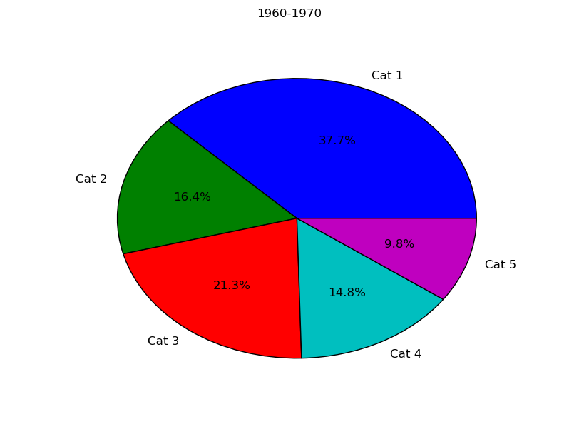
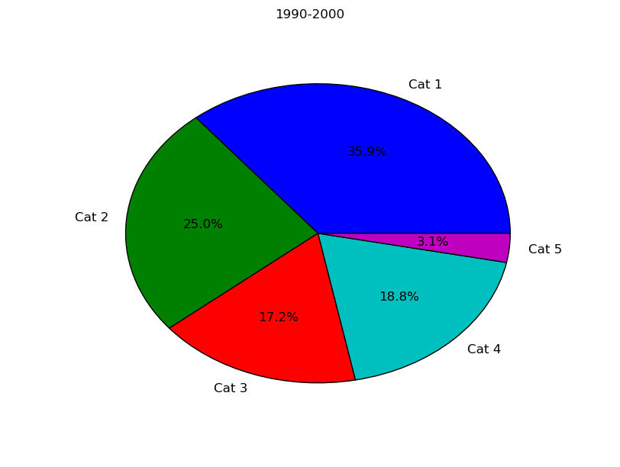
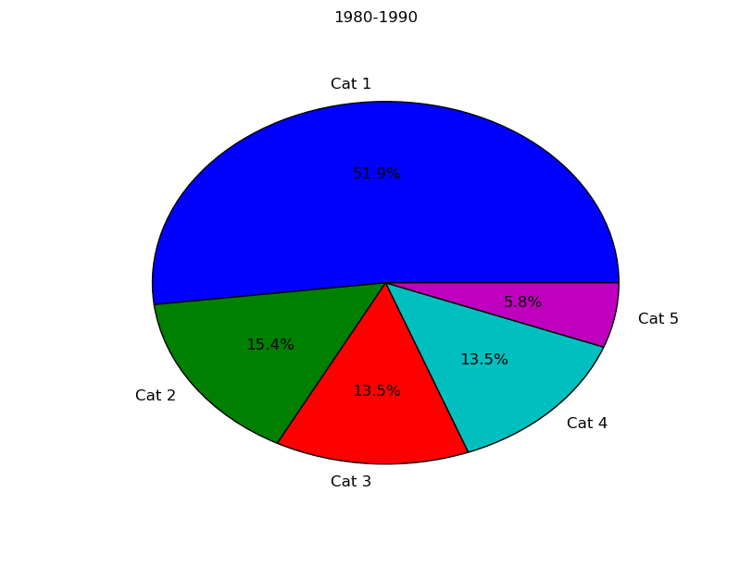
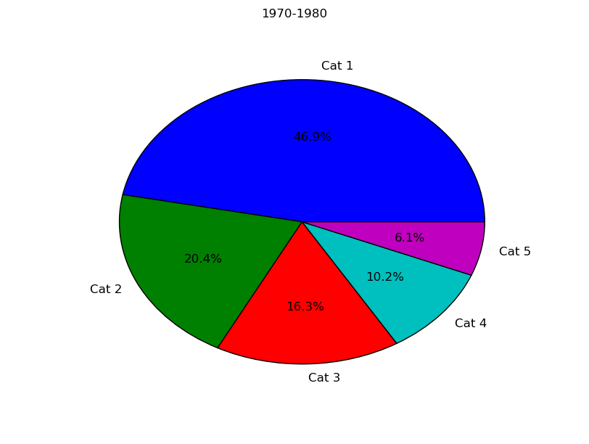
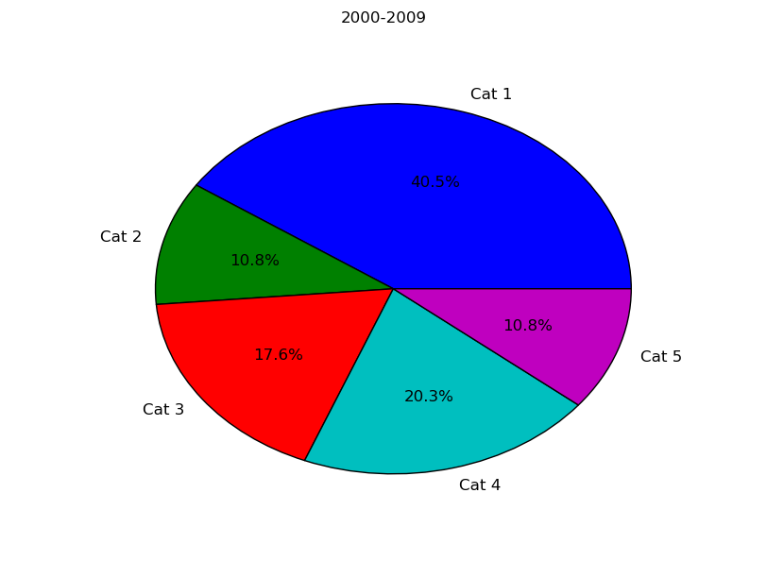
5 Cont.

Slide 7
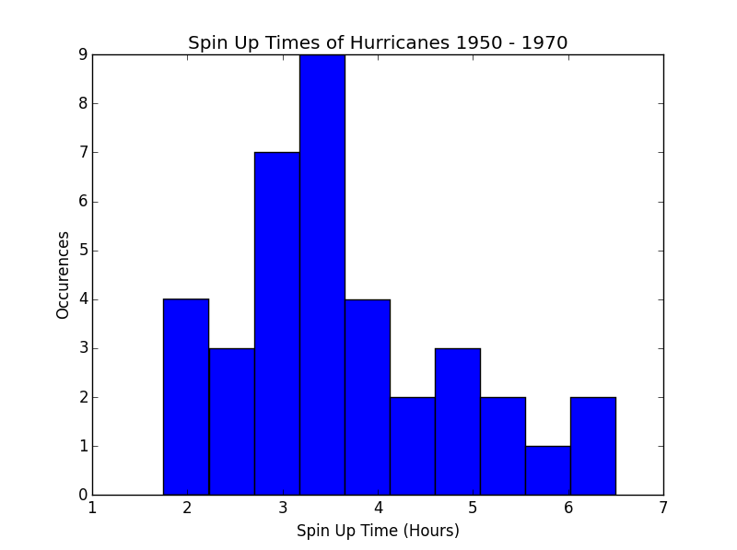
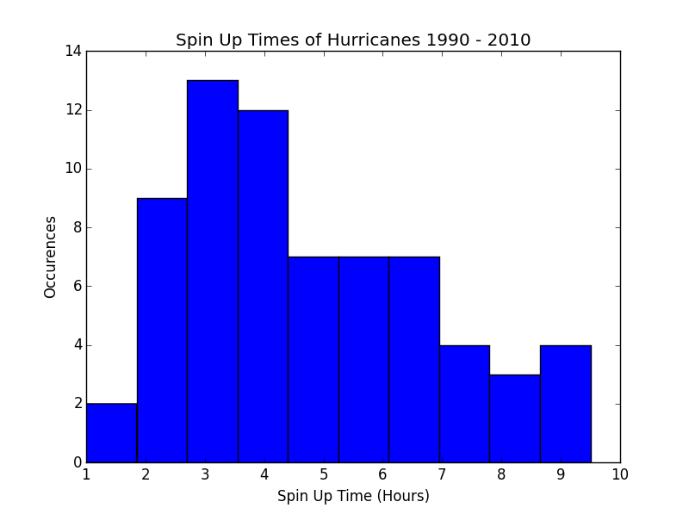
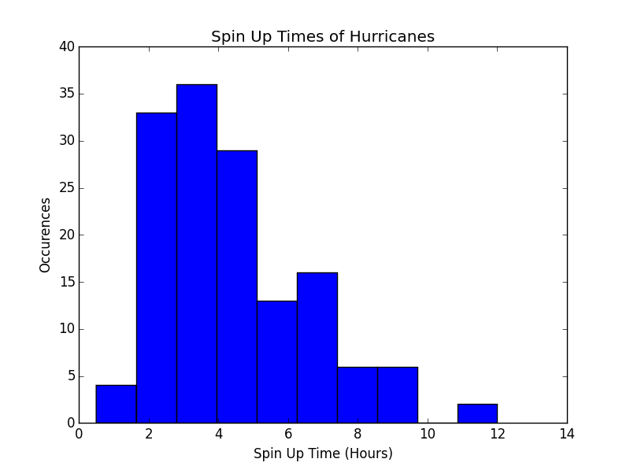
Question 6
The average spin-up time seems to be more even now than it used to be. There was a large peak around 3 hours previously, the more recent data is much smoother.

Slide 8
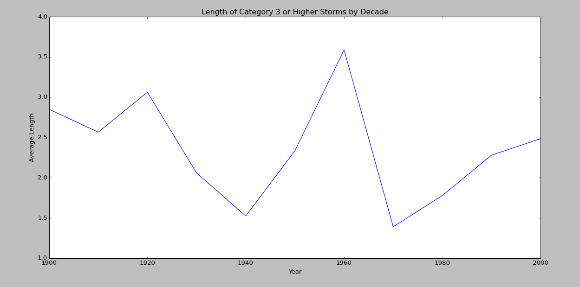
Question 7

Slide 9
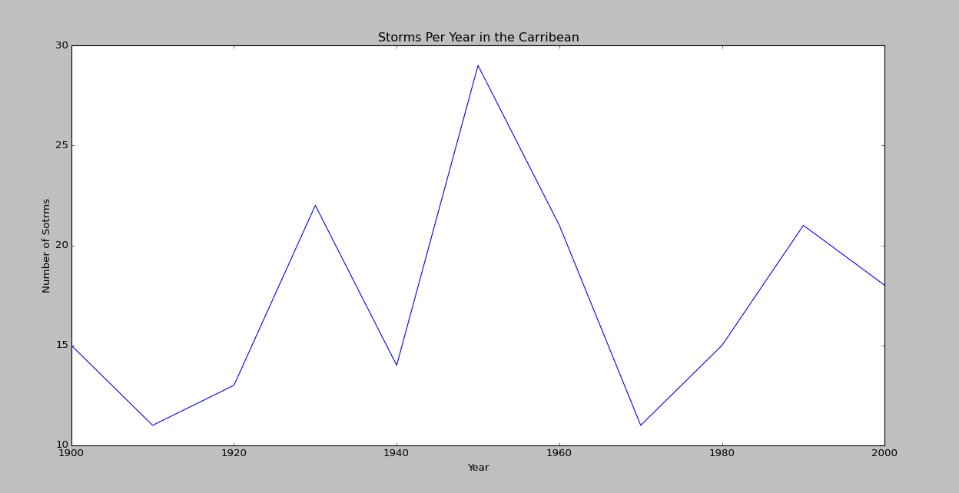
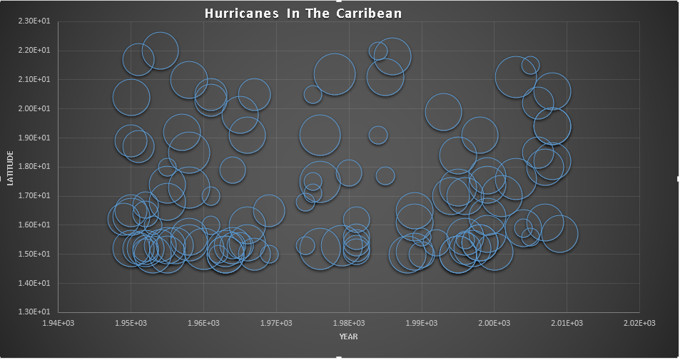
Question 8
There seem to be fluctuations in the amount of storms with a fairly regular cycle.

